Slide 1
R Workshop Session 1: Introduction to R
08/28/2022

Slide 2




Who am I? ☺
Shakiba
☺
Azadi Tower, Tehran, Iran

Slide 3
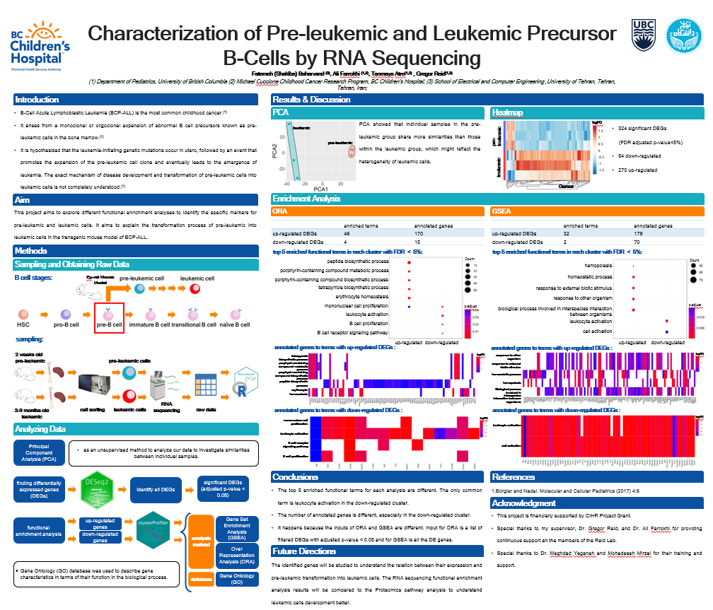
Who am I? ☺
Summer Student Research Program
Reid Lab

Slide 4
Introduction to the Workshop
RNA-seq Data Analysis
Introduction to R
Pathway Analysis

Slide 5
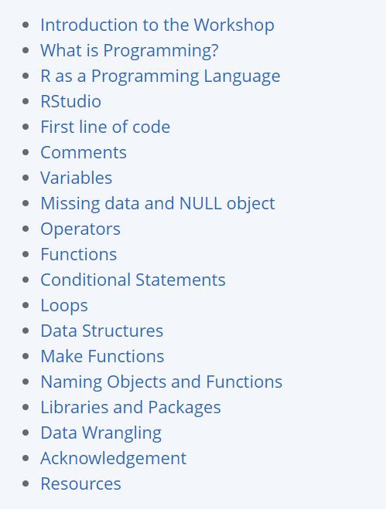
Introduction to the Workshop

Slide 6
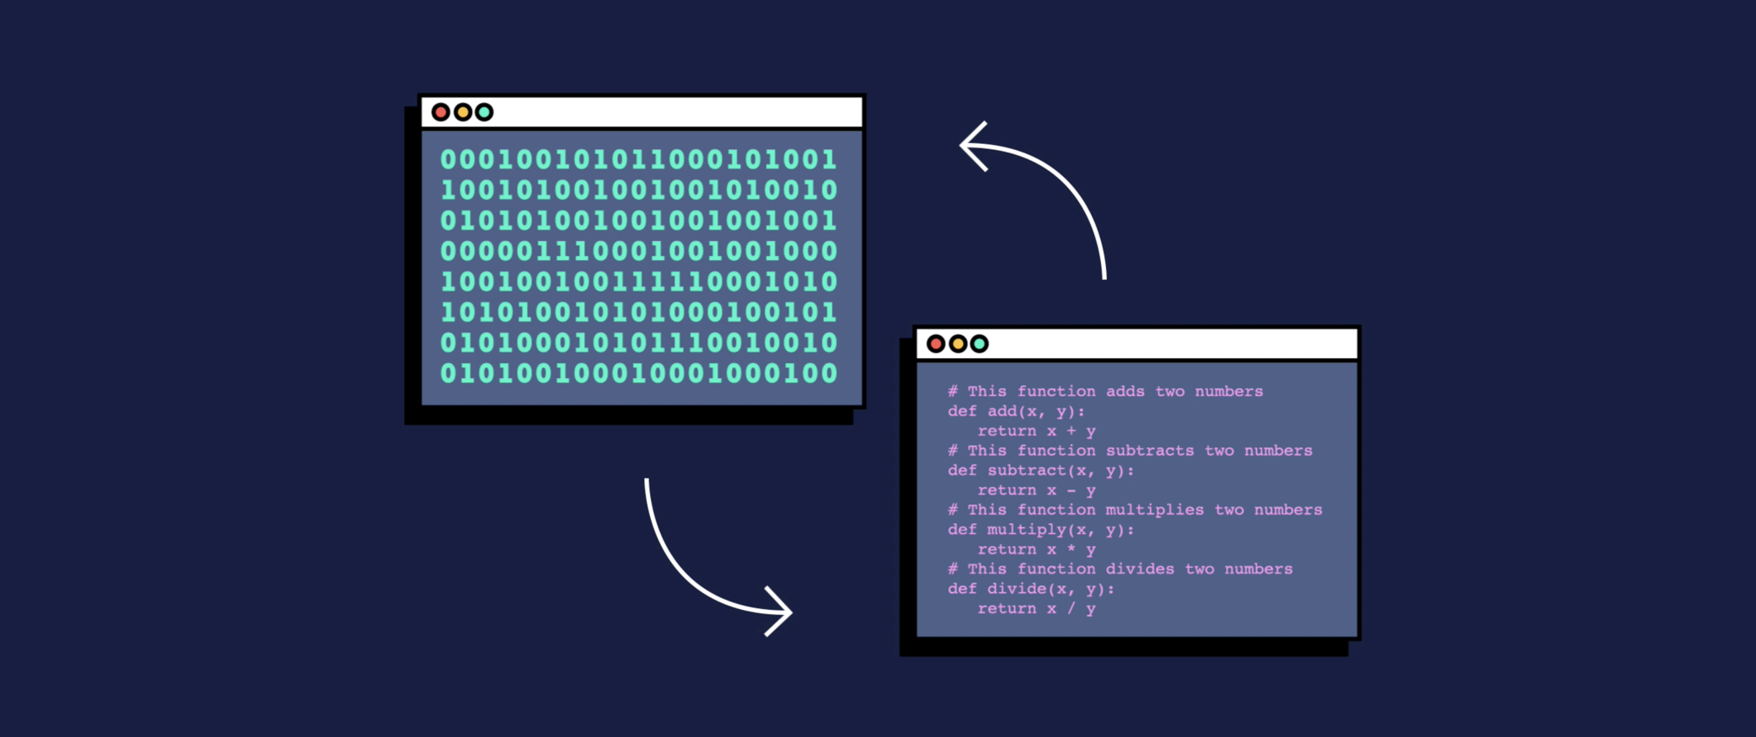
What is Programming?
Programming is giving a set of instructions to a computer to perform tasks.

Slide 7

R as a Programming Language
language
software
A system for statistical analysis and graphics

Slide 8
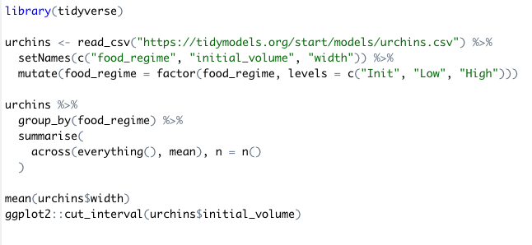
R as a Programming Language
https://timmastny.com/projects/r-syntax-highlighting-gallery/

Slide 9

RStudio
RStudio is an IDE (integrated development environment) that is used to manage and execute R code.

Slide 10
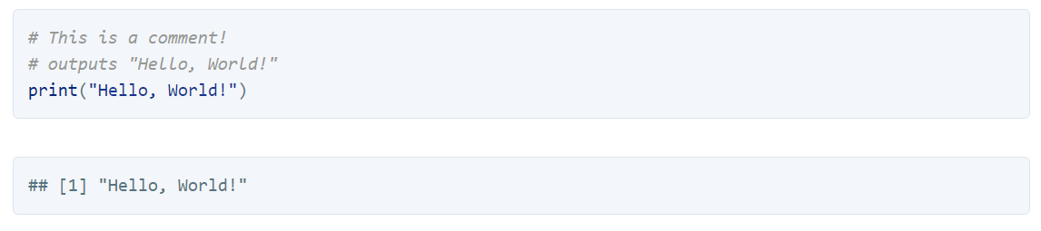
Comments
Comments are used to explain the code.
They are ignored when the program is running.
A comment can be created using # in R.

Slide 11
Variables
Variables allow us to store and manipulate data.
Variables have a name and a value.
numeric
name
value
test_message <- “Hello, World!”
integer
complex
type of data
assignment operator
character
logical

Slide 12
Variables
numeric
represents all real numbers with decimal values
double: specifies real values with decimal points
integer
It shows the real integer numbers
2 , -2, 0, 1000, -122
complex
is used to specify purely imaginary values.
1 + i, 4 - 6i
character
is used to specify character or string values in a variable.
A string is a set of characters.
logical
binary values
True or False

Slide 13
Variables
Converting between data types in R is possible.
as.logical()
as.numeric()
as.character()
as.integer()
as.complex()

Slide 14
Missing data and NULL object
The NA symbol (not available) represents missing values.
The NaN symbol (not a number) represents impossible values. (for example, dividing by zero)
The NULL object in R is used to represent the undefined values.
(We will discuss them more.)

Slide 15
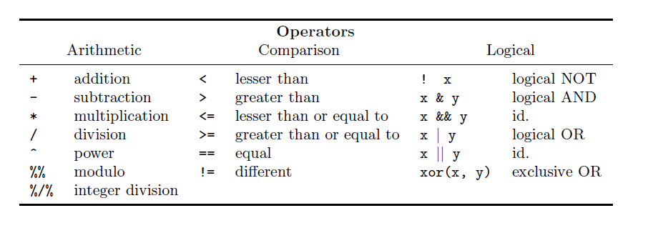
Operators
An operator is a symbol that tells the computer to perform specific actions.
R for Beginners, Emmanuel Paradis, page 29

Slide 16
Functions
Functions are a piece of code that accomplish a specific task.
Some functions are in-built in R or they are provided by the packages.
Also, you can write your own function.
arguments
function
result
var_integer <- as.integer(var_numeric)

Slide 17
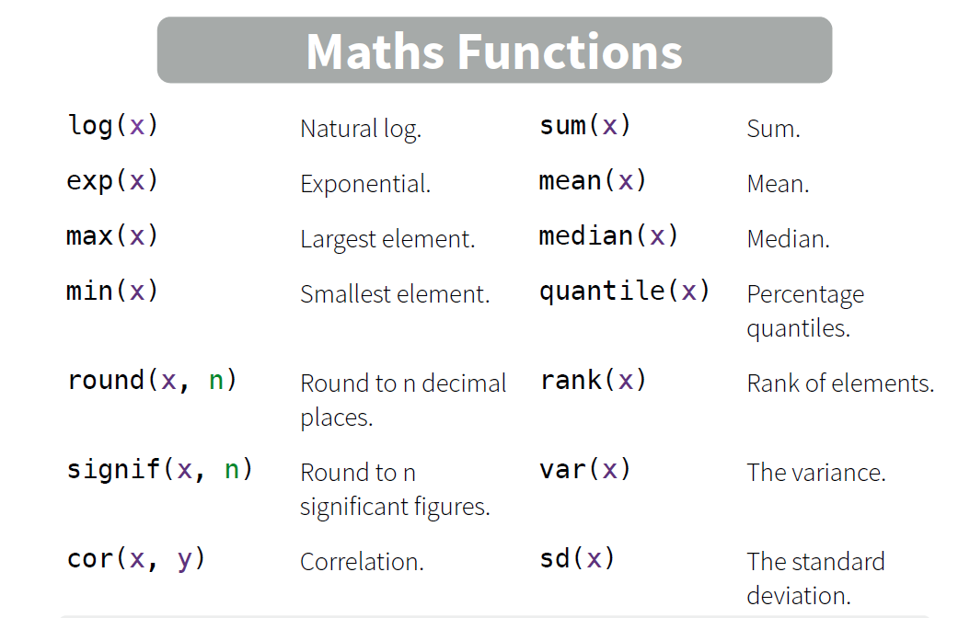
Functions
You can find useful functions from base R in the book of R for Beginners by Emmanuel Paradis on page 36 and 37.
Base R cheat Sheet

Slide 18







Conditional Statements
Conditional statements are the way computers can make decisions.
1
2
3
4
5
if n %% 2 ==1
Odd numbers
1
2
3
4
5

Slide 19
Conditional Statements
if (Condition) {
Do something
}
if (Condition) {
Do something
} else {
Do something different
}
if (Condition1) {
Do something
} else if (Condotion2)
Do something different
} else if (Condition3)
Do something different
} else {
Do something different
}

Slide 20
Loops
In computer programming, a loop is a sequence of instructions that continually repeats until a certain condition is reached.
*
**
***
****
*****

Slide 21
Loops
for ( variable in sequence) {
Do something
}
while (condition) {
Do something
}

Slide 22
Review and Practice
Comments
Write a program to print the numbers from 1 to 20, and print “Fizz” for multiples of 3, print “Buzz” for multiples of 5, and print “FizzBuzz” for multiples of both.
Variables
Missing data
Operators
Functions
Conditional Statements
Loops

Slide 23
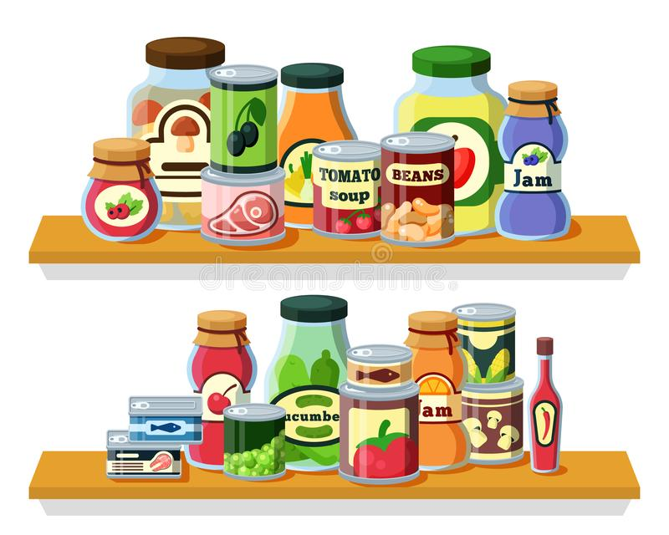
Data Structures
Data structures are methods of storing and organizing data in a computer system.

Slide 24




Data Structures
Single Dimensional:
Two Dimensional:
Three Dimensional:
Vector
Dataframe
Matrix
Array
List

Slide 25
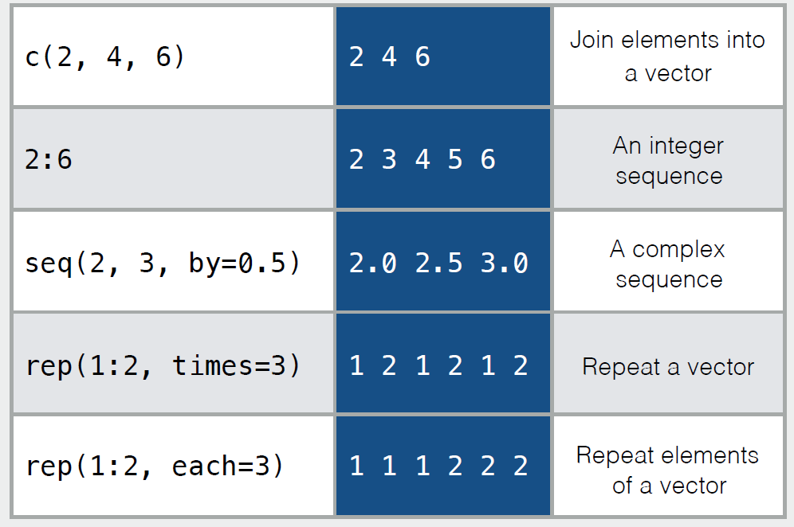
Vectors
A vector is just a set of objects of the same type.

Slide 26
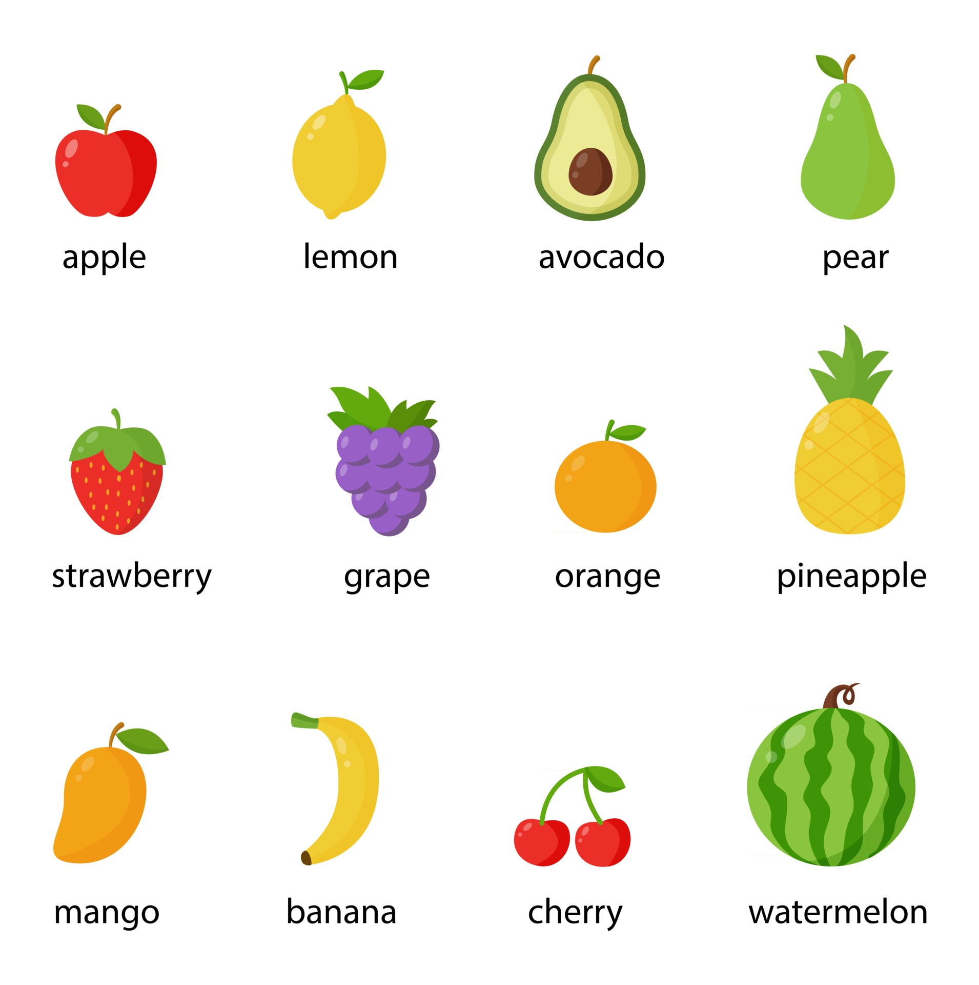
Naming a Vector
You can name a vector elements.

Slide 27
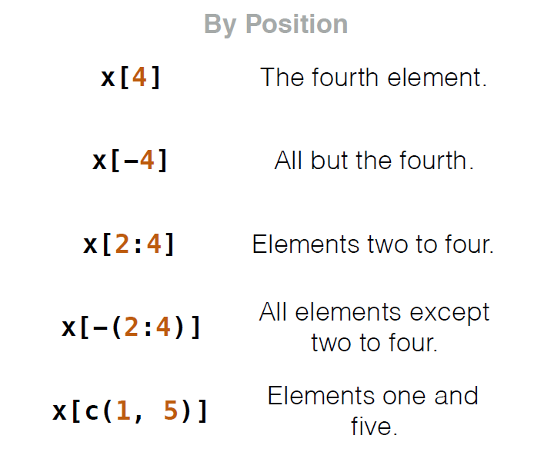
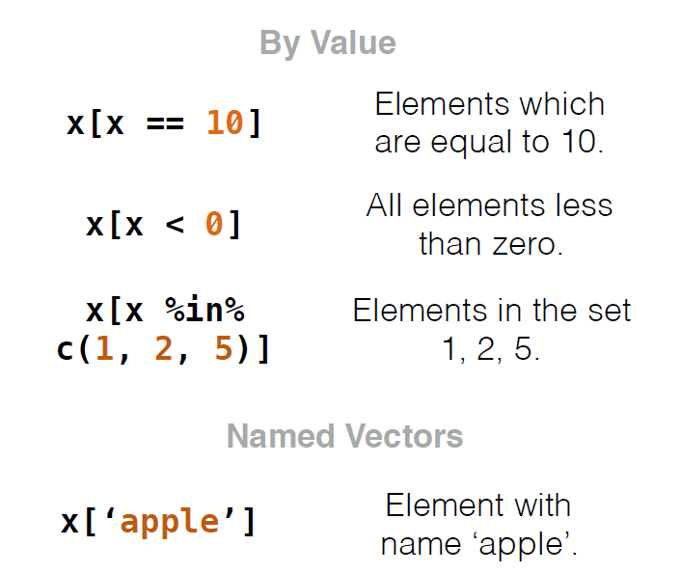
Selecting Elements

Slide 28
Order a Vector
You can order a vector with two functions. By default, these functions order a vector in ascending order.

Slide 29
Combine Vectors

Slide 30
Length of a Vector

Slide 31

Factors
Factors are used to represent categorical data.
They are kind of ordered labelled vector.

Slide 32
Data Frames
A data frame is the most common way of sorting data in R.
It is a list of equal length vectors.
Column names should not be empty in a data frame.
Row names should be unique.

Slide 33
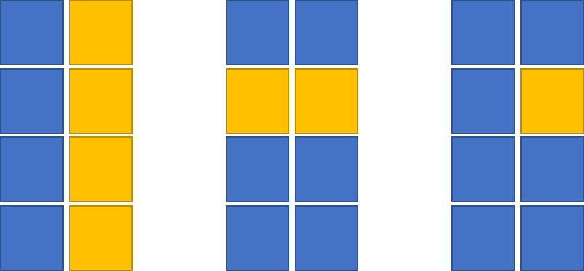
Subsetting
column
row
cell
df[ ,2]$column_name
df[2, ]
df[2, 2 ]

Slide 34
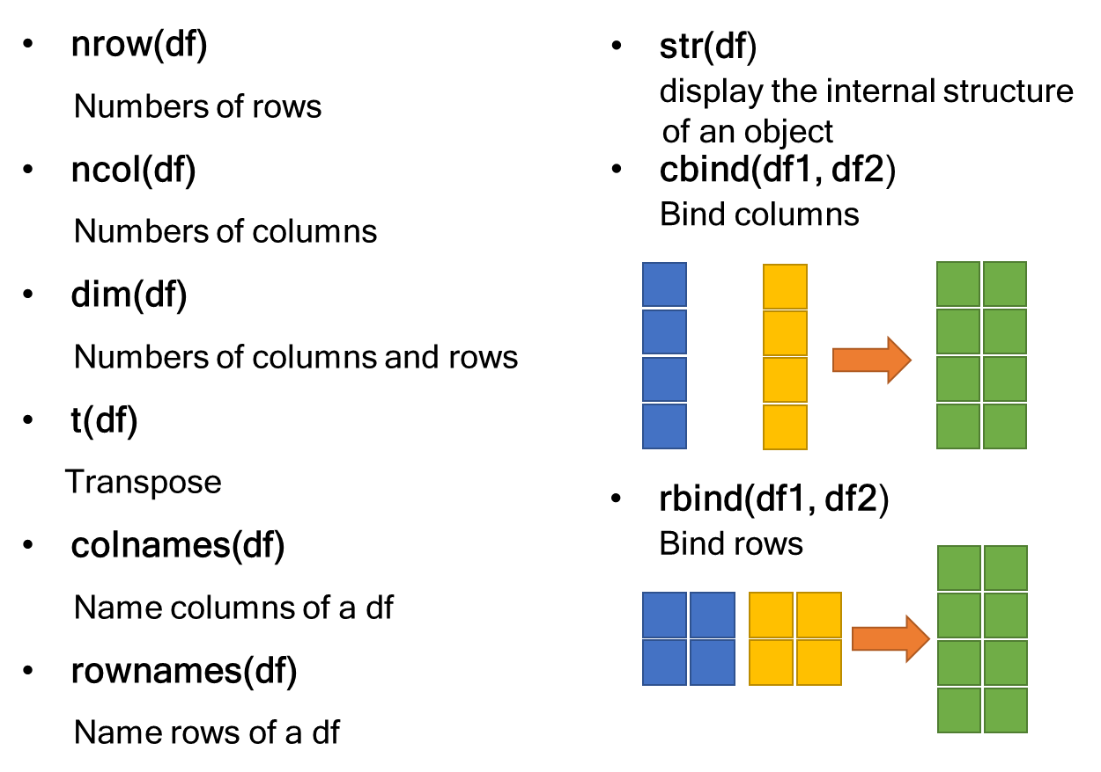
Data Frames Functions

Slide 35
Matrices
Matrix is a collection of elements of the same data type arranged into a fixed number of rows and columns.
The length of columns should be equal.

Slide 36
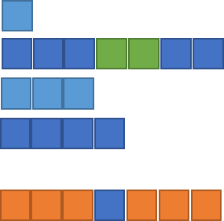
Lists
Lists are ordered collections of any R object.
It stores different types of elements.
Collections can have different lengths.

Slide 37
Selecting Elements
L [ [ 2 ] ]
Second element
L [ 2 ]
New list with only
second element
L $ x
Element named x
L [ ‘ x ‘ ]
New list with only
element named x

Slide 38
Data Structures
Converting between data structures in R is possible.
as.vector()
as.factor()
as.matrix()
as.data.frame()
as.list()

Slide 39
Review
Vectors
Factors
Data Frames
Matrices
Lists

Slide 40
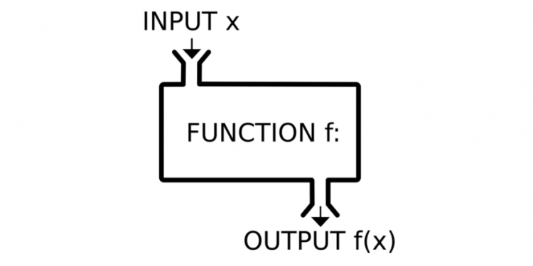
Defining a Function
Write functions for repetitive operations.
function_name <- function(argument1 , argument2,…) {
Do Something
return(output)
}

Slide 41

Naming Objects and Functions
letters, numbers, period, underscore
Coding style: snake_case
someUseUpperLettersToSeparateWords
some.use.dots

Slide 42
Naming
up_regulated_genes_from_gsea_method_and_mesh_database_list
cars_df
is_odd = TRUE
SELECTED_NUMS = 10
up_gsea_mesh_l

Slide 43


Libraries and Packages
In R, a package is a collection of R functions and data.
Packages are stored in libraries.
How to install packages
CRAN
.zip files on your computer
GitHub

Slide 44
Data Wrangling
Data wrangling Refers to various processes designed to transform raw data.
Visualize
Import
Tidy
Transform
Model
communicate
Wrangle

Slide 45

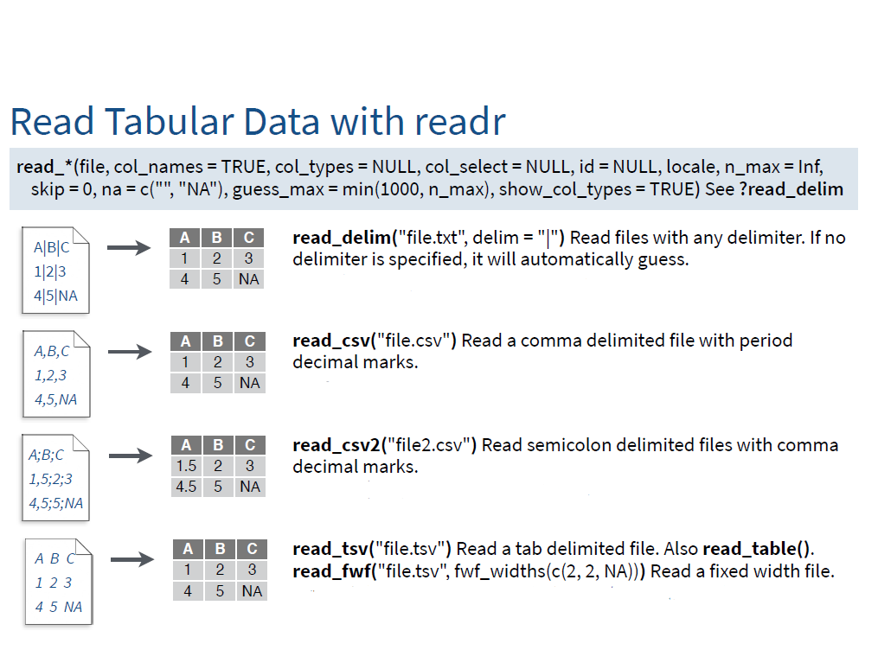
Importing
read_delim()
read_csv()
read_csv2()
read_tsv()
read_table()
read_*(file, skip = 0)

Slide 46


Importing
my_data <- read_excel("my_file.xlsx")
my_data <- read_excel("my_file.xlsx", sheet = 2)
my_data <- read_excel("my_file.xlsx", sheet = "name_of_sheet")

Slide 47

Tidy Data
Tidy data is a consistent way of storing data that makes the next steps easier.

Slide 48
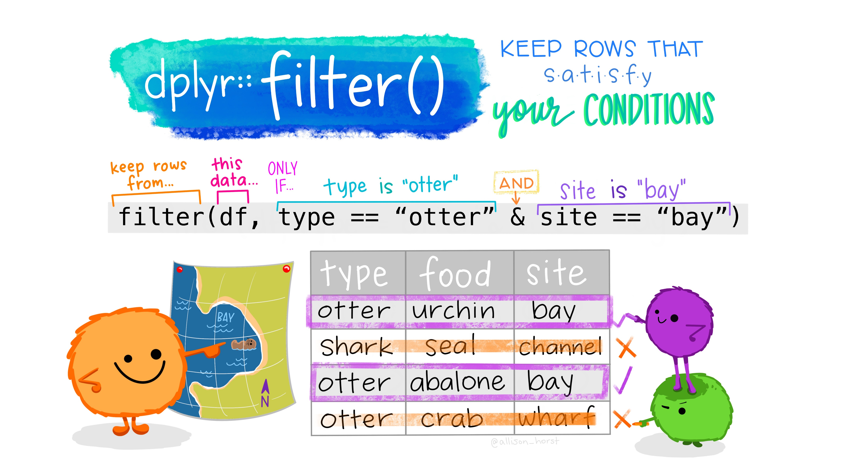
Transformation

Slide 49
Review
mutate
separate_rows
na.omit
column_to_rownames
ifelse
separate
drop_na
rownames_to_column
case_when
unite
replace_na
group_by
subset
distinct
select

Slide 50
Strings
paste(x, y, sep = ‘ ‘)
Join multiple strings together
paste0(x, y)
Join multiple vectors together
with no space between them.
paste(x, collapse = ‘ ‘)
Join elements of a vector
together.
gsub(pattern, replace, x)
Replace matches in x with a
string.
grep(pattern, x)
Find regular expression
matches in x.
toupper(x)
Convert to uppercase
tolower(x)
Convert to lowercase.
str_to_title(x)
convert the first letter of every word of a string to Uppercase and the
rest of the letters are converted to lower case.

Slide 51



Where Can I Ask For Help and Communicate With Others?

Slide 52
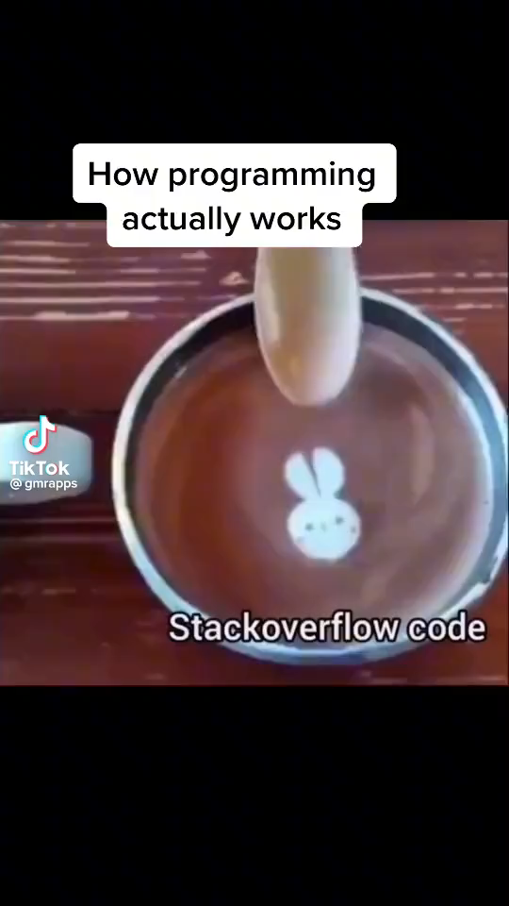
Where Can I Ask For Help and Communicate With Others?

Slide 53
Acknowledgement
I would like to thank my supervisor Dr Gregor Reid, Dr Ali Farrokhi, and Tanmaya Atre, for their support and guidance.
Also, I would like to thank Reid's lab members and all of the people who helped me to get through my project.

Slide 54


